Slide 1
AIET Project
Team Number : 19
Team Name : Josh James
NEW YORK CITY CAB FARE PREDICTION

Slide 2
Team
Ravi Kumar Suggala
Bhadrachalam Kollati
Likhitha Pericharla
Anisha Nittala
Madhuri Penmatsa
Under esteemed guidance of
Ms.NAZIL PERVEEN.

Slide 3
Agenda
A brief About Project Group Name
Team members
Problem statement
Related work
Datasets
Methods and model
Experiments and results
Future work
Conclusion
Q & A

Slide 4

Brief about the Project Group Name
JOSH JAMES
Founder and CEO of Domo.
Co-founder and CEO of Omniture.
He was named as “Technology Entrepreneur” of the decade by Brigham Young University.
DOMO specializes in business intelligence tools and data visualization.

Slide 5
Problem statement
The goal of this application is to predict the fare amount of a cab ride based on given information such as pickup and drop off locations, pickup date & time, no.of passengers.
The cab fare problem is one of several real-world problems that are used as case studies.

Slide 6
Related work
We collected dataset from Kaggle set.
Linear regression and random forests algorithms are applied and observed on this dataset.
Applied EDA analysis based on pick_up and drop_off location from different airports in New York.

Slide 7
Datasets
The data contains a training set of 55M taxi rides in New York from 2009 to 2015.
Features:
pickup_datetime
pickup_longitude
pickup_latitude
dropoff_longitude
dropoff_latitude
passenger_count
Fare_amount (Target)
We have to do In-depth analysis of the cab fares dataset.

Slide 8
Pre-processing
Cleaning of data such as
Removed all null values
Removed all trips of pick_up and drop_off locations is same
Negative fare amounts are removed
All trips with zero passengers are removed
Removing pick_up and drop_off locations, which are not located within the city geographical limits

Slide 9
Feature Extraction
Splitting of the column(pickup_datetime) into year, month, day_of_week, hour.
Calculate Distance using Haversine’s model
a = sin²(Δφ/2) + cos φ1 ⋅ cos φ2 ⋅ sin²(Δλ/2)
c = 2 ⋅ atan2( √a, √(1−a) )
d = R ⋅ c
Where φ=latitude
λ=longitude
R = radius of the earth(6371km)

Slide 10
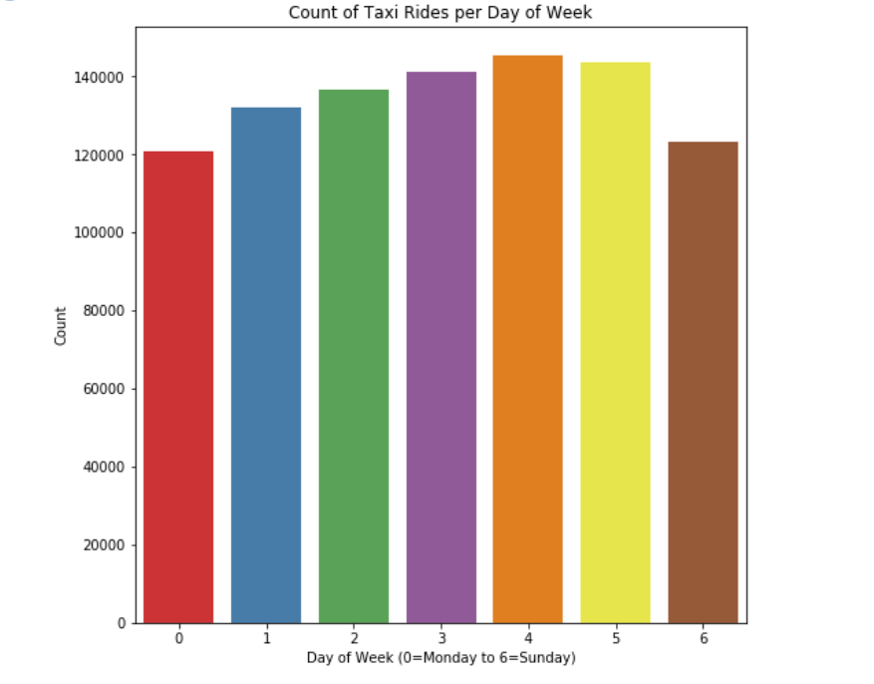
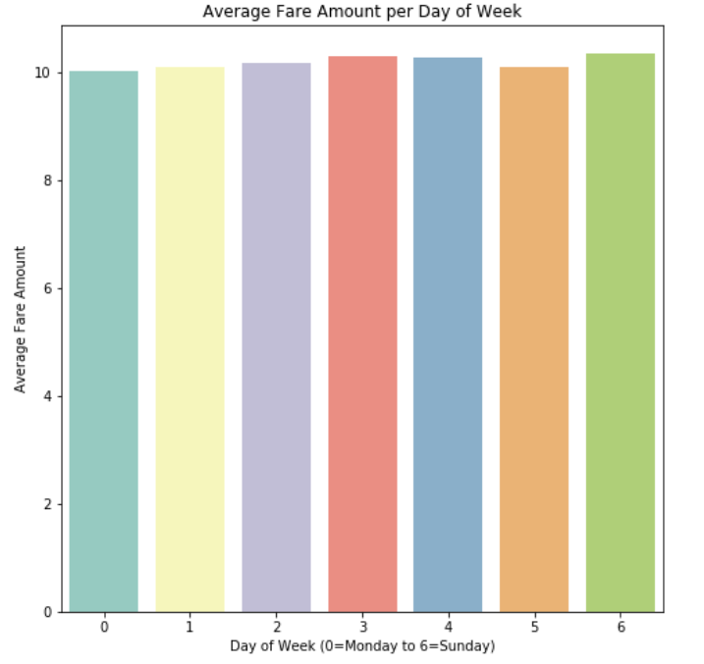
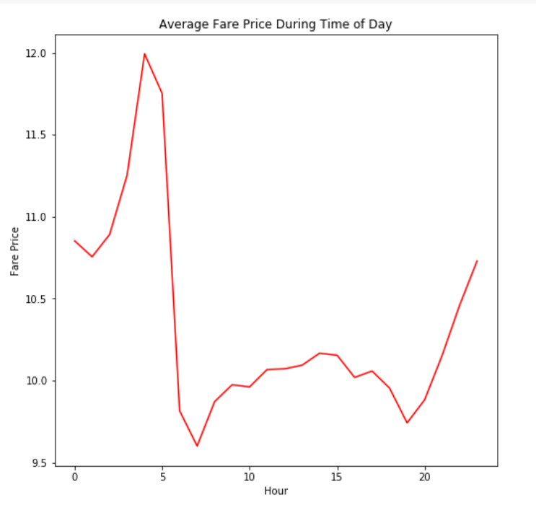
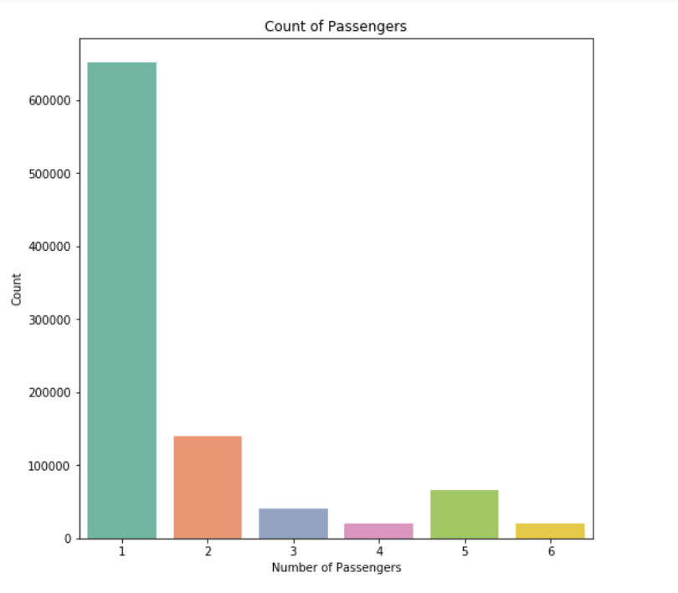
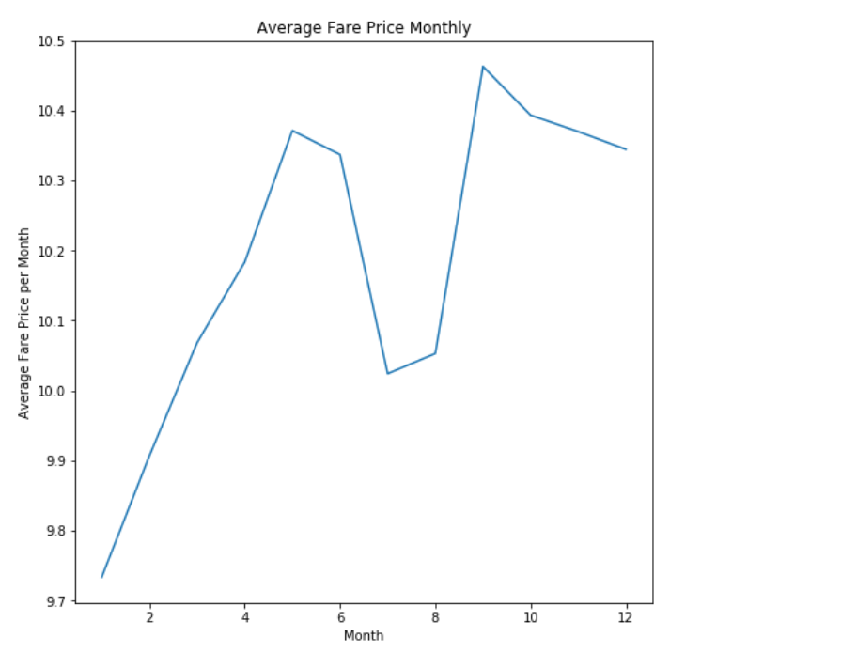
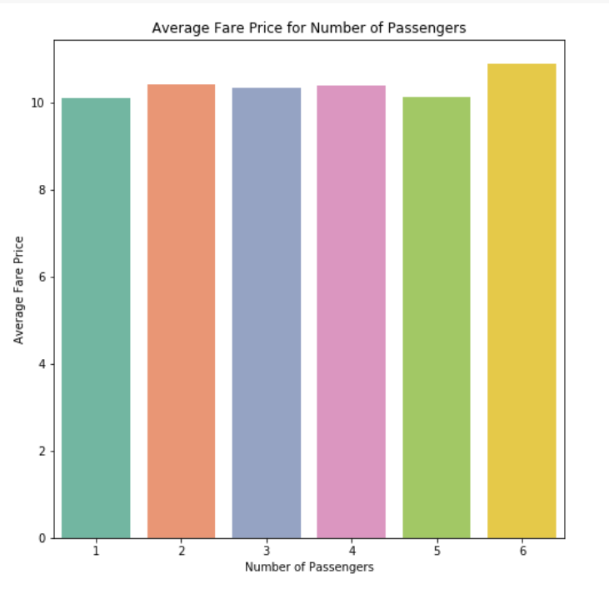
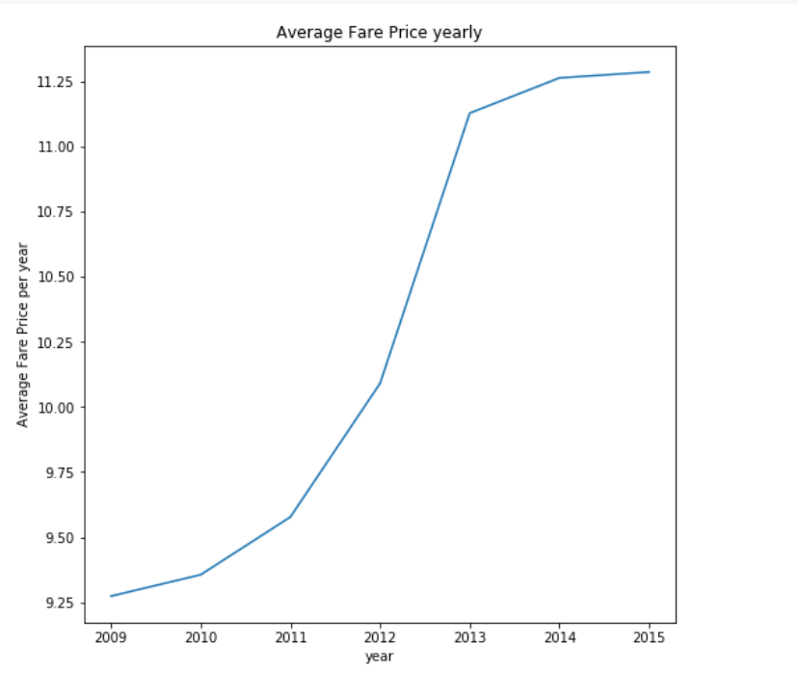
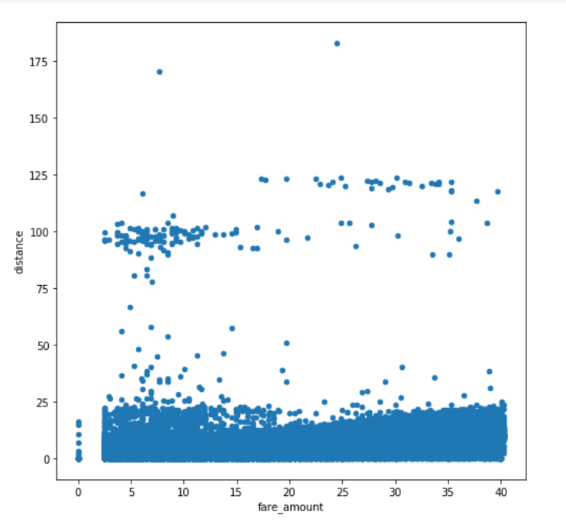
Exploratory Data Analysis (EDA)

Slide 11
Methods and model
For this project, we have chosen the following regression algorithms.
Linear Regression
Adaboosting
Random Forest
XGBoosting
Feed Forward Neural Network

Slide 12
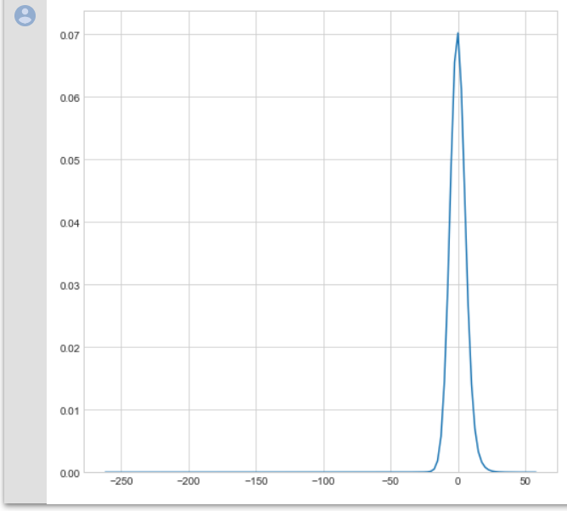
Linear Regression
A supervised algorithm that learn from a set of training samples
Helps in predicting linear relationship between target and one or more predictors.
The best fit line is the one for which total prediction error is as small as possible.
Error is the distance between the point and the regression line.

Slide 13

Random Forest Regression
Random forest is combination of hundreds or thousands of decision trees.
Booststrap aggregating(bagging) technique is used.
It provides higher accuracy. If there are more trees, it won’t allow over fitting trees in the model.
It has the power to handle a large data set with higher dimensionality.
Entropy :

Slide 14
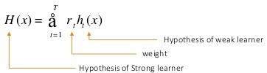
AdaBoost Regressor
Works by adding more weights on weak learners and less weights on strong classifiers.
Used to boost the performance of decision
trees on binary classification.
Extreme Gradient Boosting
It is similar to that of Gradient Boosting. The computation power of this is higher when compared to Gradient Boosting.
It gives better support for multi core processing.

Slide 15
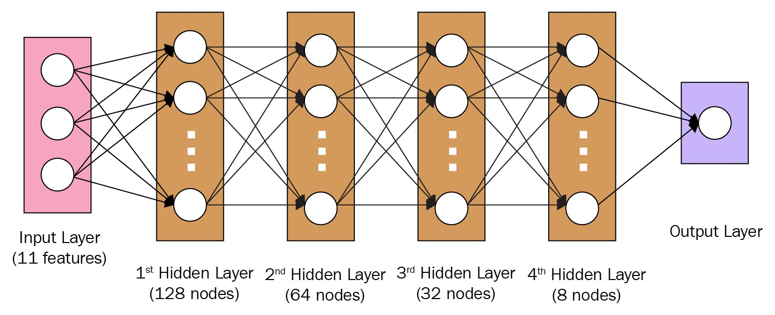
Feed Forward Neural Networks

Slide 16
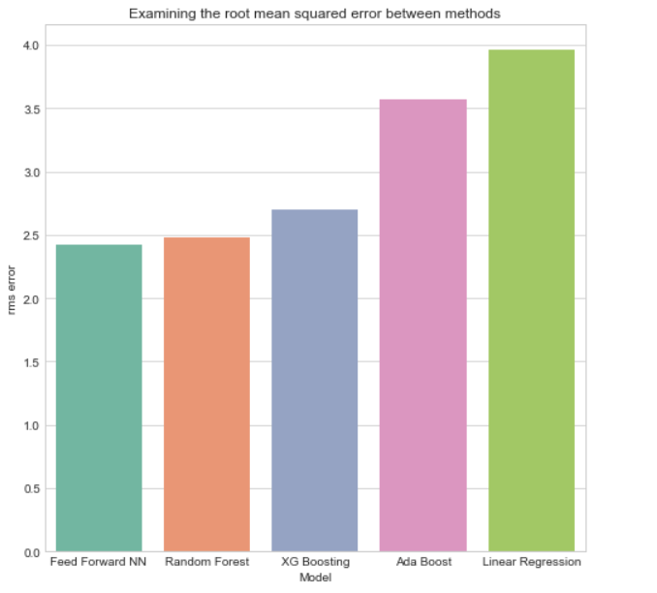
Experiments and results

Slide 17
Conclusion and Future perspective
Over the 10M trips of data set, EDA and feature extraction has been
done at maximum extent and also our Application compares the results of
ML regression algorithms reasonably on the given data set.
We hope this project can be extended to predicting cab demands in
different areas of the New York City.

Slide 18
Questions?

Slide 19
THANK YOU!

